Slide 1
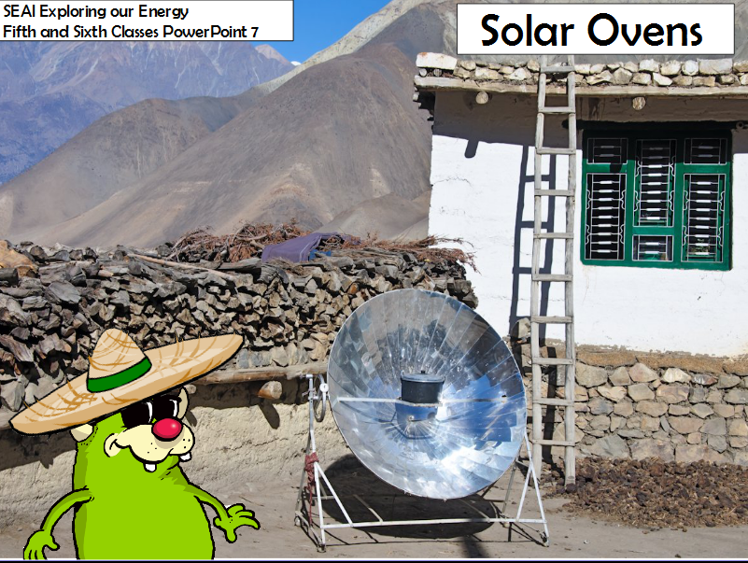
Notes:
Solar Ovens
Following discussion on solar ovens, the children make a pizza box solar oven which demonstrates radiation (energy from the sun).
Children then use the solar oven to carry out a fair test investigation. Ideally the investigation should be carried out on a sunny day.
Three solar ovens per class are required to conduct the investigation.

Slide 2
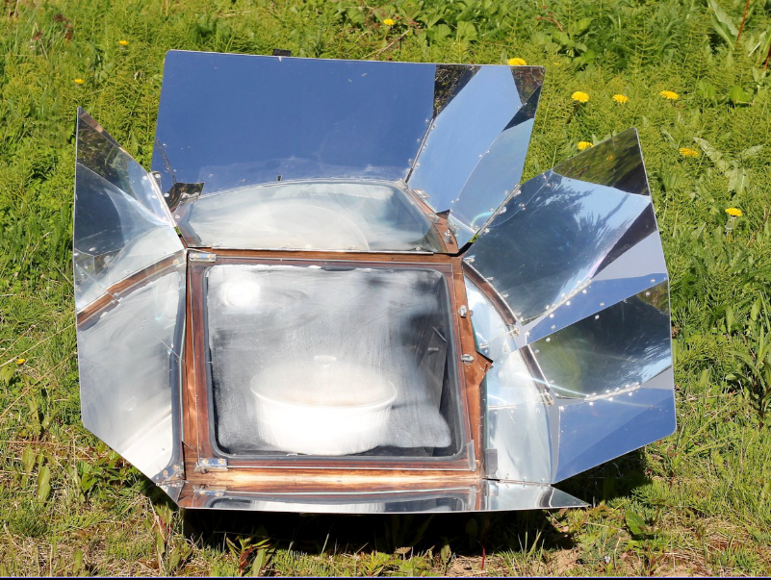
Notes:
A solar oven cooks by turning light rays from the sun into heat. The sun is the fuel source. Reflectors on the solar oven direct the light towards a dark pot because its dark colour absorbs the heat. The solar oven will not work at night or on a cloudy day, since it relies on the sunlight to work.
Box solar ovens are the easiest type of solar oven to make or buy. They can be made from wood, cardboard, plastic or metal. Basically they are a box in which the dark cooking pot is placed. The top of the box is a reflector that can be adjusted to make the rays hit the inside of the oven. These box ovens may need to be moved when the sun changes its position to get the most consistent heat.
Since solar ovens do not require any fuel other than the sun, they are becoming very popular in the developing nations in Asia and Africa especially. They don't cost a lot so many charitable organizations have begun helping to distribute them to people in areas without other options for power. Inexpensive versions are being marketed to campers so that they do not need to use fire when they are cooking outdoors. Solar ovens are inexpensive and environmentally responsible cooking solutions for people all over the world.

Slide 3
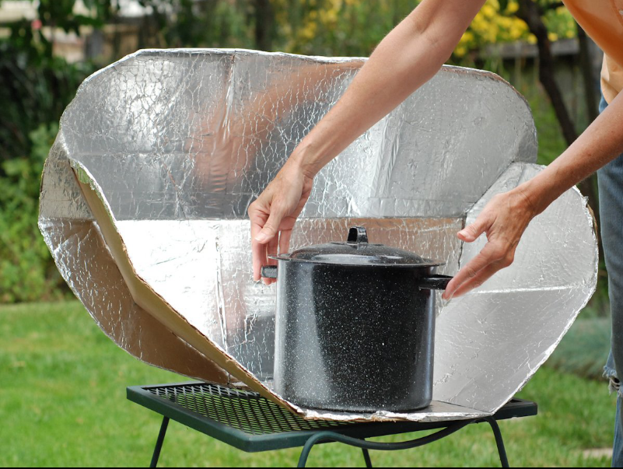
Notes:
Since solar ovens do not require any fuel other than the sun, they are becoming very popular in the developing nations in Asia and Africa especially. They don't cost a lot so many charitable organizations have begun helping to distribute them to people in areas without other options for power. Inexpensive versions are being marketed to campers so that they do not need to use fire when they are cooking outdoors. Solar ovens are inexpensive and environmentally responsible cooking solutions for people all over the world.

Slide 4
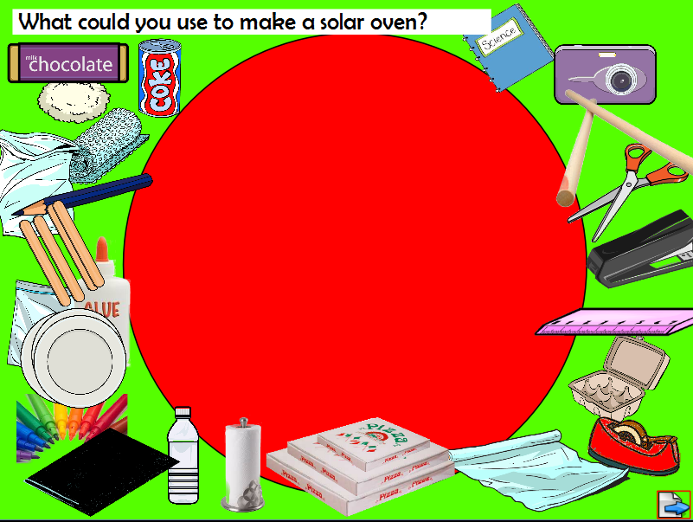
Notes:
Selecting materials for the oven
With the aid of class discussion, select the items you will use to make your oven
Resources required
3 different sized pizza boxes
Stiff black paper
Aluminium foil
Clear plastic (plastic cellophane works well)
Glue
Sellotape
Scissors
Rulers
Markers
Small bar of chocolate
3 small paper plates (to fit inside the oven)
Lollipop sticks or dowel
Blu-tac
Show the children the materials that are available to make the solar oven (see
resource list above).
Discuss the properties of these materials for example foil is a reflector of light, black paper absorbs light. Explain that they are going to make 3 solar powered ovens by attaching these materials to the inside of the pizza boxes.

Slide 5
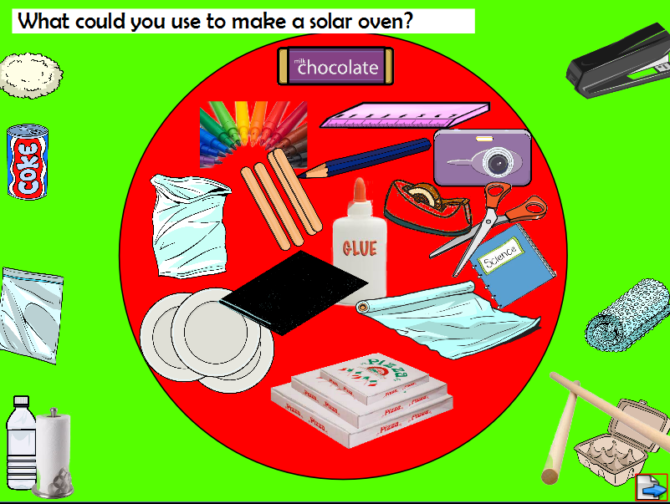
Notes:
Selected items in circle

Slide 6
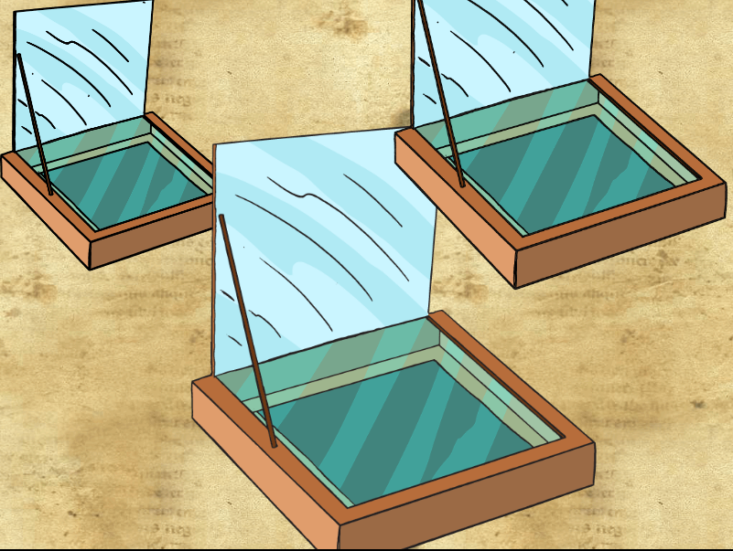
Notes:
Activity type: Investigation
This lesson investigates heat transfer and looks at one method of using the sun’s radiation as a renewable source of energy.
Brief explanation: Heat from the sun gets trapped inside the solar oven, which starts to get very hot.
How does it happen? The foil reflects rays of sunlight into the box. Rays pass through the plastic cellophane and heat up the air that is trapped inside. The black paper absorbs the heat at the bottom of the oven.
Investigation question: “Which oven will melt a square of chocolate
first?”

Slide 7
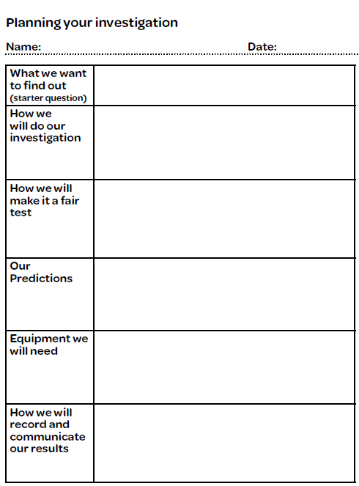
Notes:
Investigation Planning sheet
Investigation question: “Which oven will melt a square of chocolate
first?”
Present the investigation question to the children and ask them to think about how they could carry out this investigation. Each group records their ideas on PCM 14 (Planning
sheet).

Slide 8
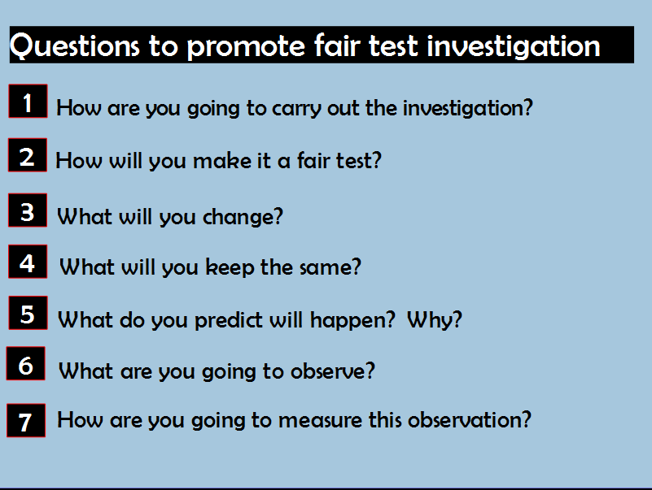
Notes:
Questions to promote fair test investigation
1 How are you going to carry out the investigation?
2 How will you make it a fair test?
3 What will you change? (size of the pizza box)
4 What will you keep the same? (position in the sun, size of the piece of chocolate)
5 What do you predict will happen? Why?
6 What are you going to observe? (the chocolate melting)
7 How are you going to measure this? (how long it takes the chocolate to melt)
Conduct the investigation by placing an equal amount of chocolate in each solar oven. Then place the three solar ovens in a sunny location. Discuss the results of the investigation. The investigation can be conducted as a whole class or group investigation, depending on how many pizza solar ovens have been made.

Slide 9
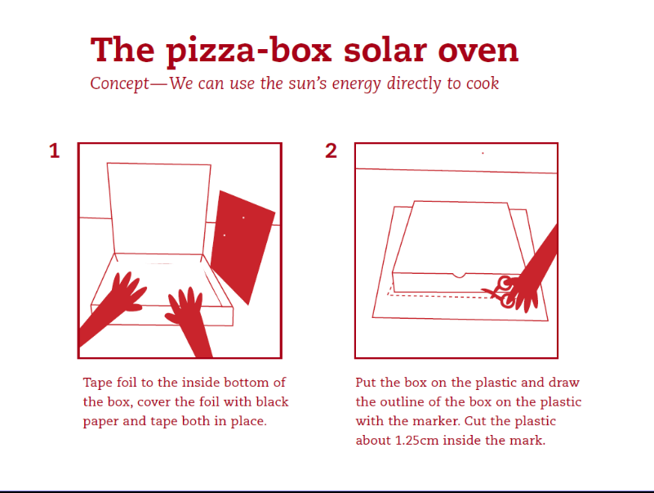
Notes:
Directions for making the pizza box solar oven are available from
The Energy File:
The pizza box solar oven (page 32)
Download from http://www.seai.ie/Schools/Primary_Schools/Resources_Available/The_Energy_File1.pdf?iframe=true&width=1024&height=768

Slide 10
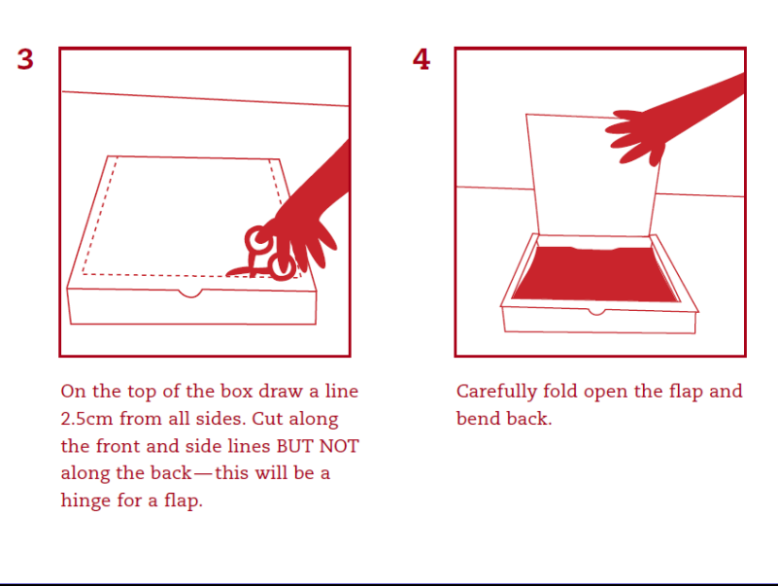

Slide 11
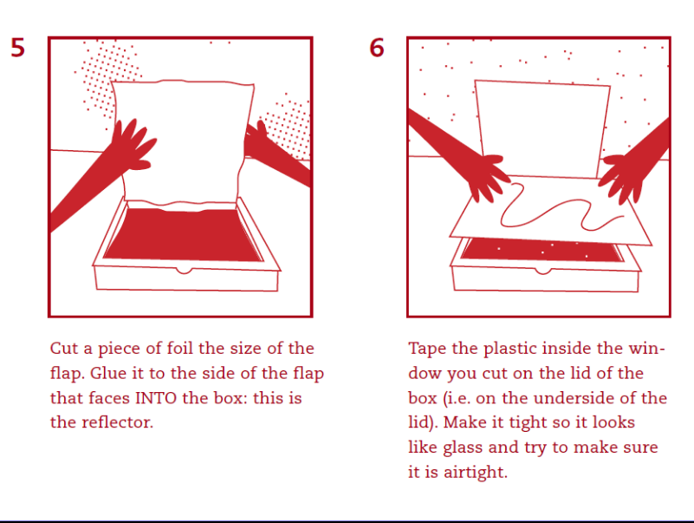

Slide 12
