Slide 1
The Health and Wealth of our Oceans
Notes:
Intro yourself/yourselves. Developed this workshop on behalf of SEAI for new Junior Cert.
Ask the question have they heard of SEAI? SEAI’s vision that “Ireland’s energy will be sustainable, secure, affordable and clean. To achieve this Ireland must, use less (being energy efficient) and use clean (exploiting renewable energy). SEAI are working with homeowners, businesses, communities and government to achieve this vision”. Energy is used in so many ways in our lives and there are a lot of individual actions that we can take to reduce our overall energy use. This workshop focuses on some of our own individual actions and some of the consequences for our oceans

Slide 2
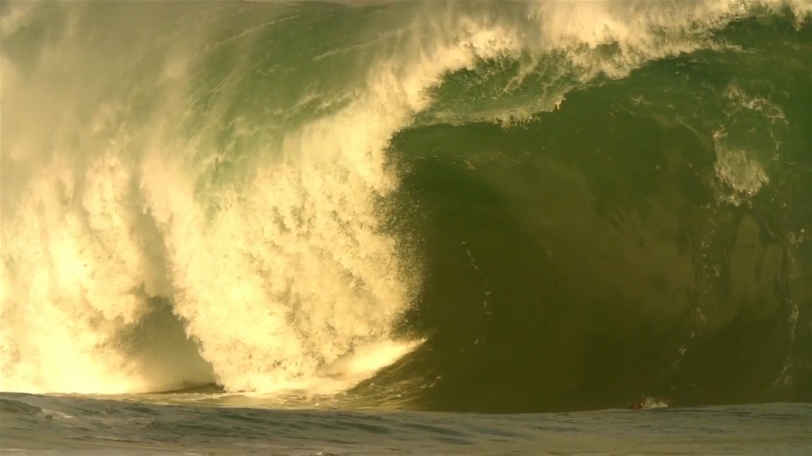
Notes:
Introduce who Easkey is i.e. Irish Surfing Campion with a doctorate in Environment and Society. This is her quote which represents the main topics of our workshop. Take a minute to think about what it means to you before we move on. We will be asking you to discuss it further in our next activity.

Slide 3
Sustainable Energy
You have 10 minutes to discuss the images in your groups in terms of their links to Energy, Oceans and Sustainability. Think of as many connections as you can.
Write a word or sentence for each connection on a post-it and stick it beside the larger image on the wall
  Energy (yellow post-it)
  Oceans (blue post-it)
  Sustainability (green post-it)
Notes:
The idea of this activity is to introduce the key concepts of the workshop and assess participants’ initial understanding of the connections between our actions and the consequences for climate change and our oceans.
Each group will have copies of 6 pictures (listed below) printed on 2 x A4 sheets and there will be a larger A4 copy of each picture to be placed on the wall. (The pictures will not be laminated as the addition of unnecessary plastic would be unsustainable and at odds with the theme of our workshop – A4 size makes them easy to reprint if they need to be replaced)
A radiator (represents heat which is mainly produced from fossils fuels)
A pylon (represents electricity – also mainly from fossil fuels)
A car (represents transport, fossil fuels, plastic pollution from tyres)
A plastic bottle (represents the energy used in sourcing raw materials and manufacturing, the energy used in recycling and the plastic waste in our oceans)
A plate of food with meat and vegetables (represents the energy used in growing, packaging, transporting and cooking our food and the resultant waste)
An ocean energy image (represents the wealth of our oceans, an alternative energy source to fossil fuels)
The main discussion will take place at the individual tables and the post-its are used to sum up the points discussed. (about 5 minutes) Some groups may have links that other groups didn’t have and they can be asked to explain those. If sustainability is not a concept they are very familiar with, it will be explained in more detail in the next slide. What we want here is their own ideas about what it means.
Energy links might include the source of the energy – fossil fuels vs renewable, CO2 produced, Global warming and rising sea levels
Ocean links might include rising sea levels due to CO2 production, ocean oil spills due to fossil fuel use, plastic waste in our oceans
Sustainability links could include all of the above plus sources of our food, land use, palm oil, food waste, management of resources

Slide 4
Terms
Sustainable Development
“development that meets the needs of the present without compromising the ability of future generations to meet their own needs”
Our Common Future (The Brundtland Report) 1987
Sustainable Energy
“Our vision is for Ireland’s energy to be sustainable, secure, affordable and clean. To achieve this, Ireland must use less energy, move to clean energy, and innovate to create new solutions to meet our energy needs”
SEAI
Notes:
We have already introduced the concept of sustainability in the previous exercise with groups coming up with their own ideas about what it means. Now we introduce the terms Sustainable Development and Sustainable Energy. Our use of energy and resources has long-term implications for our world. In our workshop we are going to look at the consequences of some of our actions and how our personal choices matter.

Slide 5

Notes:
Introduce the video to tie in with the theme of the workshop. 2nd year students discussing their project on how increased CO₂ from energy needs are effecting Coral Reefs.

Slide 6
pH Demonstration
Using the contents of your STE(A)M box, design and conduct an experiment to show the effect that the CO₂ we produce in our daily lives, has on our oceans.
Record results.
Vinegar
Bicarb
Balloon
Sea water
Container
pH meter / thermometer
Notes:
Discuss results after – fair test, graphing/measuring opportunities. Highlight small CO2 production is having a very real impact on ocean acidification.
Where is the excess CO2 coming from?
What other problems are caused by excess CO2 production? – Climate Change
What are the consequences of Climate Change globally and locally
How do our personal choices affect CO2 production? – Lead in to next few slides

Slide 7
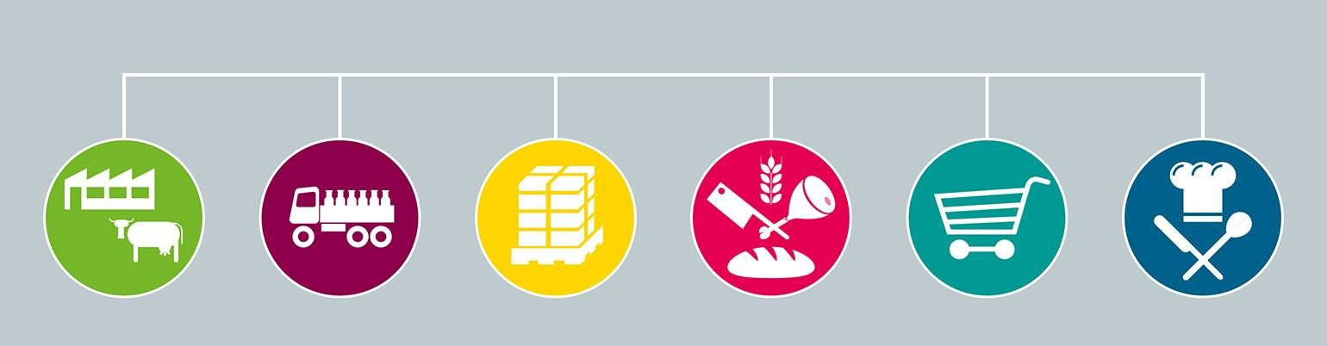

Energy and Our Food Choices
Notes:
What energy resources are needed to bring (meat or any specific food item, maybe let them decide which food item for more variety in discussions) to your table?
Make a list of all the energy resources that are used in the whole process.
Discuss all the places that CO2 and other greenhouse gases are being produced

Slide 8
Your Shopping Trolley
Calculate approximately what mass of chicken, beef and vegetables you consume, in a month, in Kg.
Average masses:
Food | Form | Mass
Chicken | Full (boneless) | 660g
Chicken | Fillet | 113g
Chicken | Burger | 77g
Beef | Steak fillet | 180g
Beef | 1 portion of mince | 115g
Beef | Burger | 113g
Vegetable | Burger | 71g
Vegetable | ½ cup | 75g
Notes:
These are only approximates found on livestrong.com
Encourage participants to make educated guesses if they want to change the mass of items slightly

Slide 9
Graphic Representation
Calculate the average masses for your group
Display your results on a chart.
Beef – pink, Chicken – yellow, Vegetables - green
Each post-it has the value of 1Kg. Construct accordingly.

Slide 10

Carbon Footprint
 | CO₂ equivalent (kg) | Equivalent car travel in kms (petrol car)
1kg Beef | 27 | 101.4
1kg Chicken | 6.9 | 25.8
1 kg Vegetables | 2 | 7.2
Source: http://www.greeneatz.com/foods-carbon-footprint.html
Google Maps
Notes:
CO₂ Equivalent
Other greenhouse gases are emitted apart from just CO_{2.} We convert these to the equivalent amount of CO₂
1kg CH₄ (from livestock) = 25kg CO₂
1kg N₂O (from fertiliser) = 298kg CO₂
If each burger weighs 125g, how much CO₂ would be produced by one beef / chicken / veggie burger
If you ate 1 burger per week, what would the CO₂ output be for one year?

Slide 11
 | CO₂ equivalent (kg) | Equivalent petrol car travel (km)
1 x Beef Burger | 3.4 | 12.6
1 x Chicken Burger | 0.9 | 3.2
1 x Veggie Burger | 0.25 | 0.9
52 x Beef Burger | 176.8 | 655.2
52 x Chicken Burger | 46.8 | 166.4
52 x Veggie Burger | 13 | 46.8
The average petrol car produces 130g/km of CO₂, the average electric car produces an average of 60g/km
Notes:
These figures are for an average petrol car. The average electric car produces just less than half the CO2 taking into account the electricity generation so the equivalent car travel would be double

Slide 12
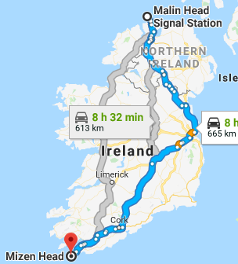
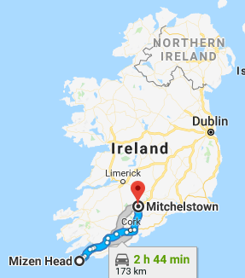
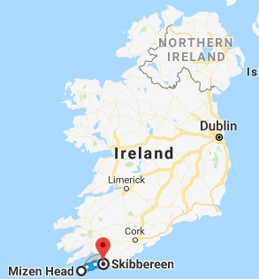
Beef Burger
Chicken Burger
Veggie Burger
Notes:
These maps are based on the average petrol car. Eating one beef burger per week for a year would be the equivalent of travelling from Mizen Head to Malin Head (via Dublin) and back in an electric car

Slide 13
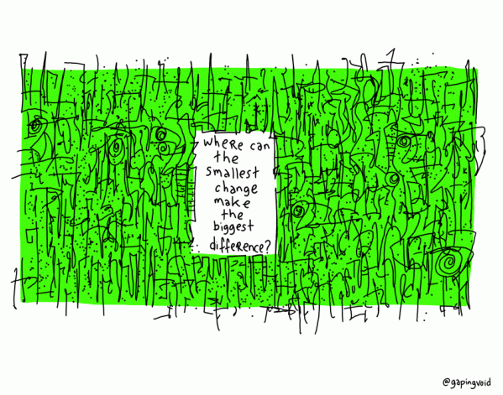
Make a Change – Personal Choices
Notes:
What effect will changes have on your chart. How many kg of veg is the equivalent of 1 kg of beef? If you make a weekly substitute on your food choices how will that effect your monthly carbon footprint?
Why does our Carbon Footprint matter? – Refer back to discussions on climate change

Slide 14
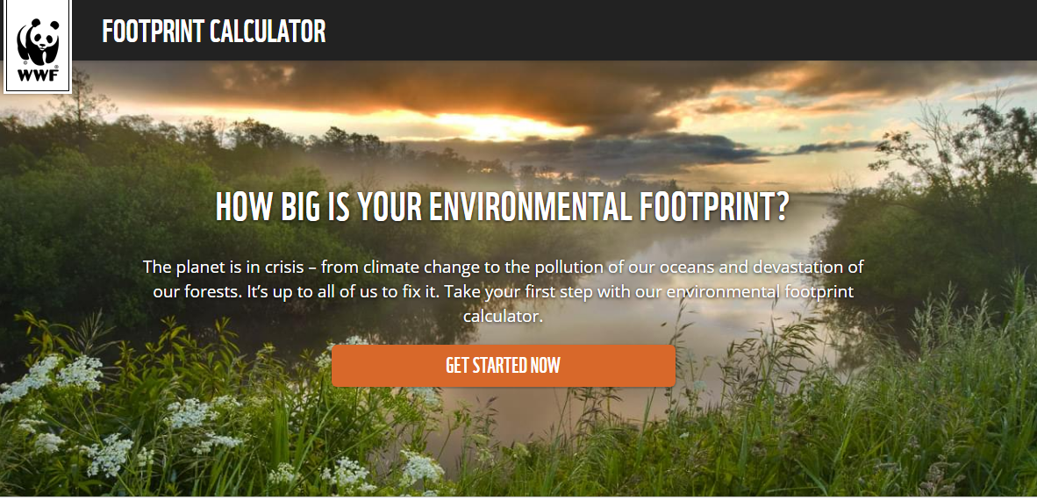
Carbon Footprint Calculator
What other factors effect your carbon footprint?
https://footprint.wwf.org.uk/

Slide 15
Notes:
Mention One Good Idea competition and show first 2 minutes of this video of TY students from Abbey Community College, Roscommon presenting their project on oceans.
Talk about the alignment of the project with current junior cycle spec across science, geography, home ec and CSPE. Link to video https://www.youtube.com/watch?v=1dClVxH0GJs&t=12s

Slide 16
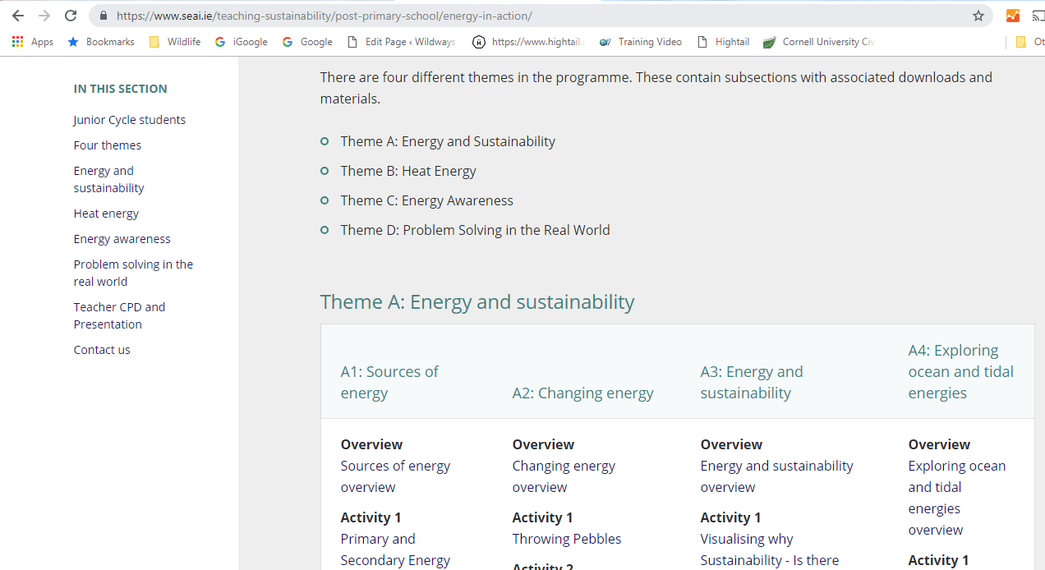
SEAI Resources
https://www.seai.ie/teaching-sustainability/post-primary-school/energy-in-action/
Notes:
Other SEAI resources on Energy and Sustainability can be found on the website. Show where to locate them.

Slide 17
Your Choice!
What changes will you make to be more sustainable?
Sustainable Energy
“Our vision is for Ireland’s energy to be sustainable, secure, affordable and clean. To achieve this, Ireland must use less energy, move to clean energy, and innovate to create new solutions to meet our energy needs”
SEAI

Slide 18
Specifications
Where could you use some today’s activities in you classroom? What outcomes are you covering?
Science
Maths
Home Economics
Geography

Slide 19
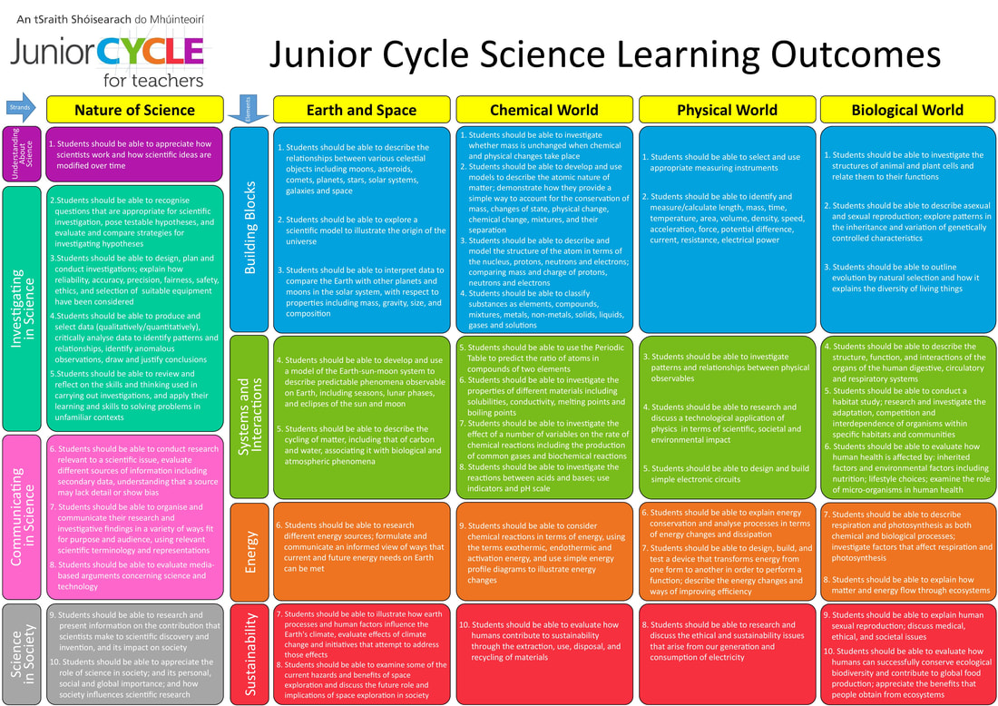

Slide 20
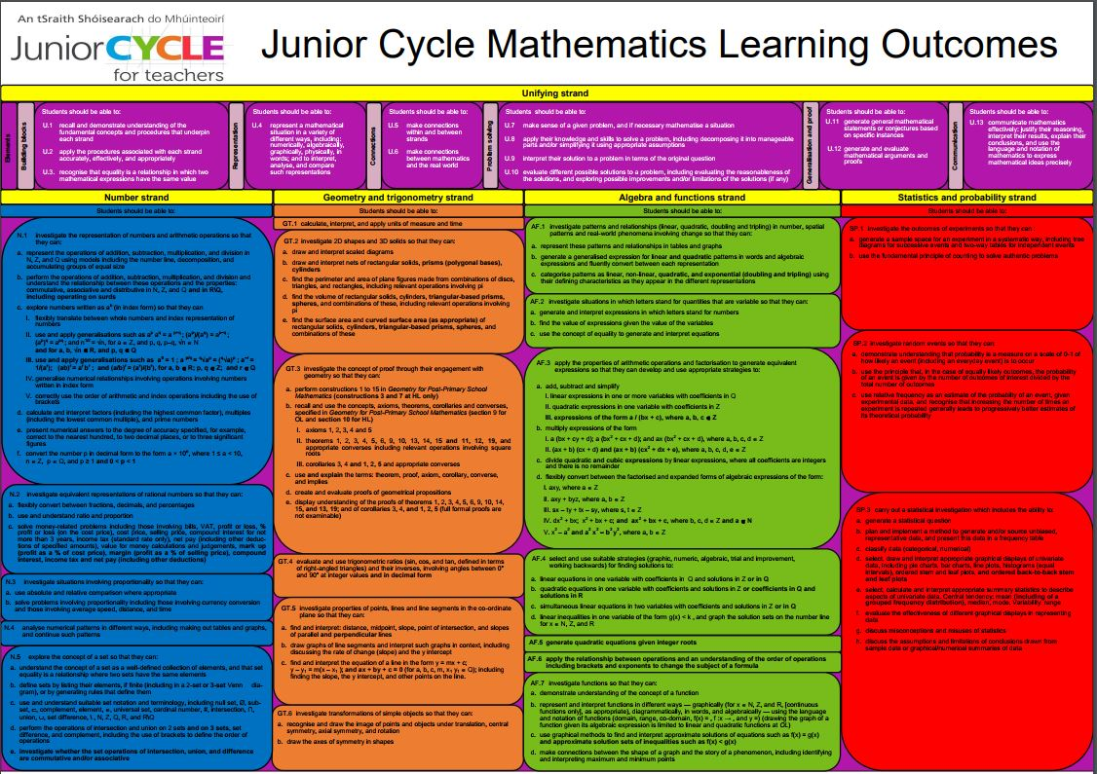

Slide 21
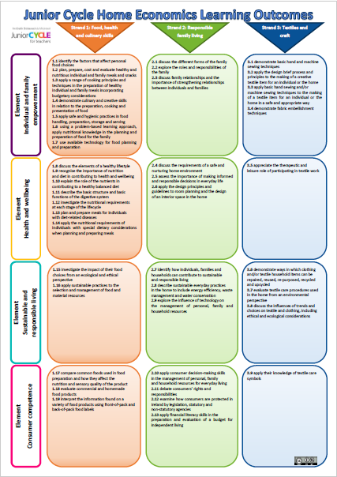

Slide 22
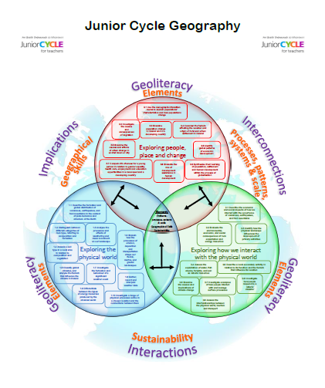

Slide 23
Learning Outcomes
Science EaS7: Illustrate how earth processes and human factors influence the Earth's climate, evaluate effects of climate change and initiatives that attempt to address those effects
Science CW10: Evaluate how humans contribute to sustainability through the extraction, use, disposal, and recycling of materials
Home Economics 2.7: Identify how individuals, families and households can contribute to sustainable and responsible living
Home Economics: 1.15 Investigate the impact of their food choices from an ecological and ethical perspective
Geography: 2.6 Examine the causes and implications of climate change
Maths: U.7 make sense of a given problem, and if necessary mathematise a situation

Slide 24


Stay in touch
Sign up to our e-newsletter
Visit our website www.seai.ie
Contact schools@seai.ie

