Slide 1

Orla Coyle– NZEB and High Performance Retrofit- Programme Manager
26th September 2019
Better Energy Communities
NZEB and Major Renovation

Slide 2
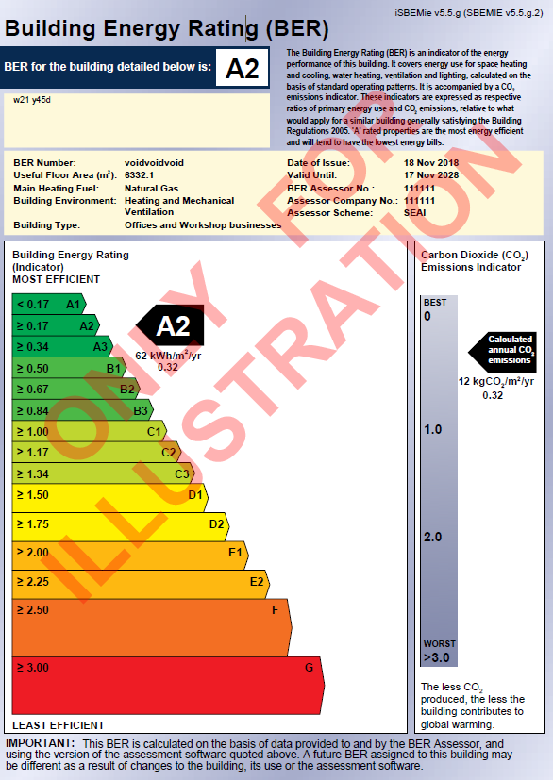
Energy Performance of Buildings Directive
Member states to ensure that all new buildings are “Nearly Zero Energy Buildings” by 31st Dec 2020
Member states to ensure that all new buildings owned and occupied by Public Authorities are `Nearly Zero Energy Buildings’ after 31st Dec 2018
Major Renovations to be at Cost Optimal Level in Building Codes .

Slide 3
Energy Performance of Buildings Directive
Article 9 Nearly Zero Energy Buildings are defined as…..
“nearly zero-energy buildings” means a building that has a very high energy performance, as determined in accordance with Annex I. The nearly zero or very low amount of energy required should be covered to a very significant extent by energy from renewable sources, including energy from renewable sources produced on-site or nearby;”
Article 7 Major Renovations to be at Cost Optimal Level in Building Codes .
“more than 25% of the surface area of the building envelope undergoes renovation”

Slide 4
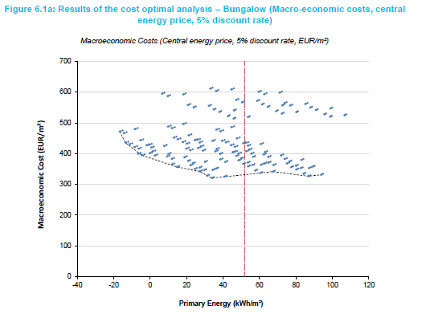
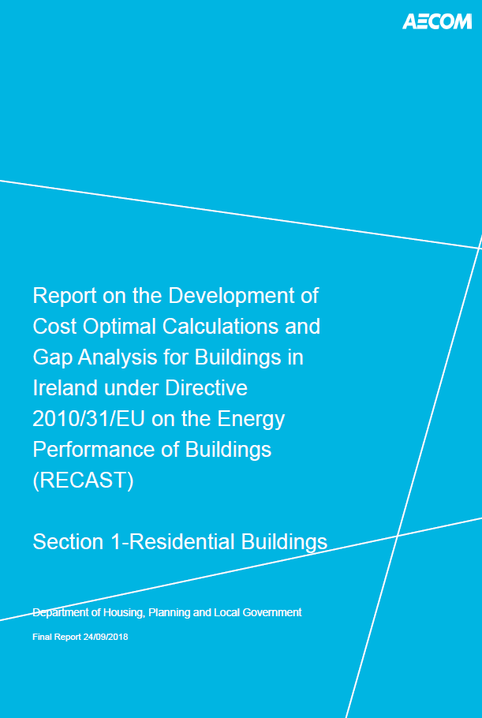
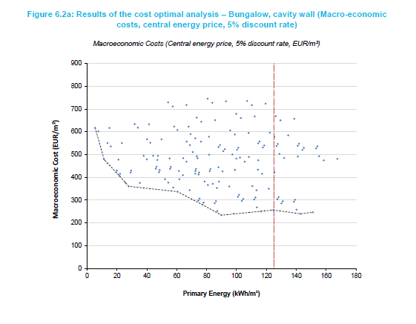
Cost Optimal Study

Slide 5
Dwelling

Slide 6
Implementation of EPBD-Part L Dwellings
SI 4 of 2017 amended Building Regulations to include the definition of NZEB
Part L of the Building Regulations 2018 for dwellings
  Applies to new dwellings commencing construction from 1st November 2019
  Transitional arrangements; Where planning approval or permission for buildings has been applied for on or before 1st November 2019, and substantial work has been completed by 31st October 2020

Slide 7
Overview of Key Changes to TGD L Dwellings
Introduction of NZEB, MPEPC=0.30, MPCPC=0.35, RER 20%
Introduction of Major Renovations to a cost optimal level where technically, economically and functionally feasible.
Reduction of air permeability backstop from 7m³/hr/m² to 5m³/hr/m²
Table 1- Reduction of wall backstop UV from 0.21W/m²K to 0.18 W/m²K
Table 1- Reduction of window backstop UV from 1.6 W/m2K to 1.4 W/m2K
Inclusion of guidance to avoid overheating in dwellings
Par 1.3.2.5 –removal of variation of U Value with percentage glazing
Introduction of calculation of Ru value for corridors in apartments.

Slide 8
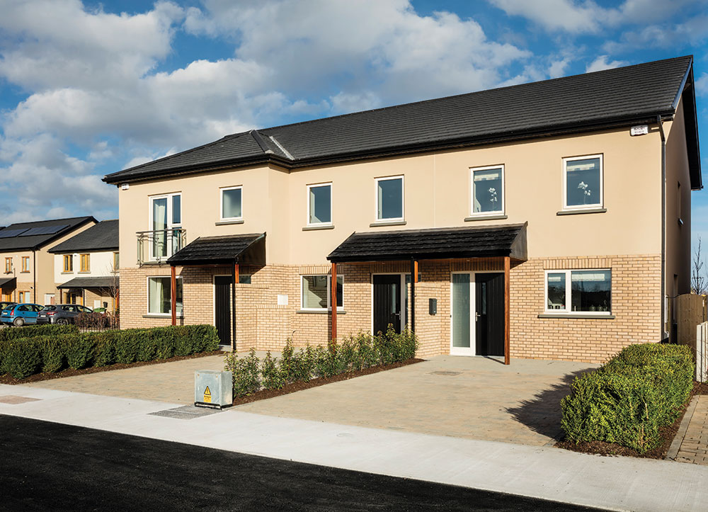
Domestic – New Buildings - NZEB
25% Improvement on Current Regulations
Same Fabric Performance
- Boiler with Increased PV
- Boiler with MVHR and PV
- Heat Pump
MPEPC: 0.3
MPCPC: 0.35
RER: 20%
Durkan Homes – Citywest

Slide 9




Typical Semi Detached House

Slide 10
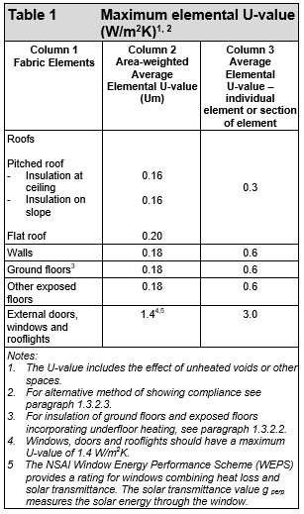
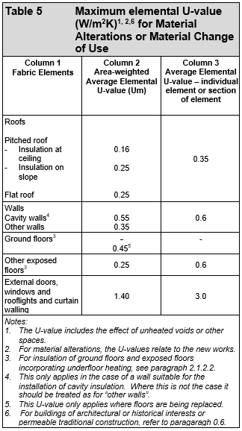
Backstop U values

Slide 11
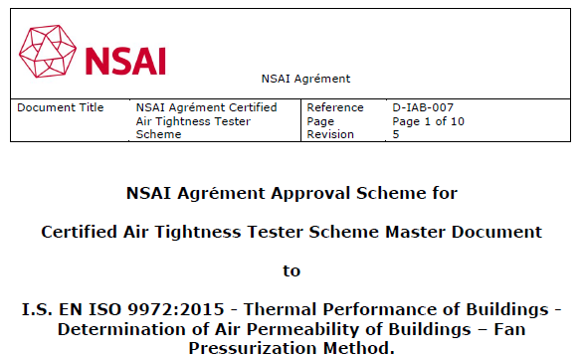
Air Tightness Test
Reduction of air permeability backstop from 7m³/hr/m² to 5m³/hr/m²

Slide 12
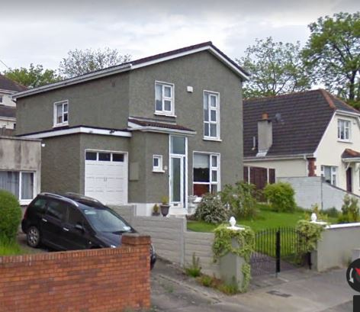
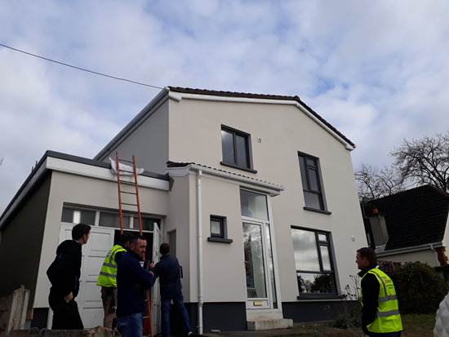
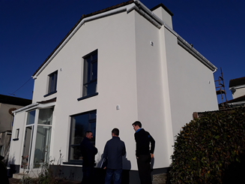

Domestic – Existing Buildings – Major Renovation
Upgrade
Fabric
Heating & Controls
Deep Retrofit Supported Project
“more than 25% of the surface area of the building envelope undergoes renovation”

Slide 13
What works are included
 | Works to Elements
External Walls | External Insulation of heat loss walls Replacement or upgrade of external wall structure Internal lining of the surface of heat loss walls
Window Renovation | Replacement of Windows
Roof Renovation | Replacement of Roof Structure
Floor Renovation | Replacement of Floors
Extension | Extension works which affect more than 25% of the surface
Where major renovation of walls, roofs and ground floors constitute essential repairs due to fire, storm or flood damage or damage as a result of a material defect such as reactive pyrite it is not considered economically feasible to being these to cost optimal level
Painting, replastering, rendering, re-slating, re-tiling, cavity wall insulation and insulation of ceiling are not considered major renovation works.

Slide 14
Major Renovations – Domestic
Cost Optimal Works activated by Major Renovation
Major Renovation > 25% surface area^{1,2,3,5} | Cost Optimal level as calculated in DEAP (Paragraph 2.3.3 a. ) | Works to bring dwelling to cost optimal level in so far as they are technically, economically and functionally feasible (Paragraph 2.3.3 b. )
External walls renovation | The cost optimal performance level to be achieved is 125 kWh/m²/yr. | Upgrade insulation at ceiling level where U-values are greater than in Table 5 & Oil or gas boiler replacement⁶ & controls upgrade where the oil or gas boiler is more than 15 years old and efficiency less than 86% &/or Replacement of electric storage heating⁷ systems where more than 15 years old and with heat retention not less than 45% measured according to IS EN 60531.
External walls and windows renovation
External walls and roof renovation
External walls and floor renovation
New Extension affecting more than 25% of the surface area of the existing dwelling’s envelope (see 2.3.6) | The cost optimal performance level to be achieved is 125 kWh/m²/yr | Upgrade insulation at ceiling level where U-values are greater than in Table 5 & Oil or gas boiler replacement⁶ & controls upgrade where the oil or gas boiler is more than 15 years old and efficiency less than 86% &/or Replacement of electric storage heating⁷ systems where more than 15 years old and with heat retention not less than 45% measured according to IS EN 60531 & Upgrade insulation at wall level where U-values are greater than in table 5.
Notes:
Table 5 insulation at ceiling = 0.16 W/m2K
Table 5 insulation at wall = 0.55 W/m2K cavity wall, 0.35 W/m2K other wall.

Slide 15
Major Renovations – Domestic
Semi Detached (126m2):
Hollow Block wall,
pitched roof with 50mm mineral wool insulation on the ceiling,
double glazing with 6mm air gap and a U value of 2.8 W/m2K,
80% efficiency gas boiler installed with no controls
Fuel Stove
Proposed Works to Elements | Major Renovation | Additional Works
A) Window Replacement (13% of envelope) | No | NA
B) EWI or IWI of walls (35% of envelope) | Yes | Upgrade insulation at ceiling to 0.16 W/m2K or table 5 AND Upgrade heating system and controls OR Achieve 125 kWh/m²/yr.
C) EWI or IWI of walls and windows replacement (48% of envelope) | Yes
D) EWI or IWI of walls and replacement of roof structure (61% of envelope) | Yes
E) EWI or IWI of walls and replacement of floor (61% of envelope) | Yes

Slide 16
Major Renovations – Domestic
Terraced house (96m2):
solid wall,
pitched roof with 50mm mineral wool insulation on the ceiling,
double glazing with 12mm air gap and a U value of 2.8 W/m2K,
68% efficiency gas boiler installed with no controls
Proposed Works to Elements | Major Renovation | Additional Works
A) Window Replacement (15% of envelope) | No | NA
B) EWI or IWI of walls (22% of envelope) | No | NA
C) EWI or IWI of walls and ceiling insulation (53% of envelope) | No | NA
D) EWI or IWI of walls and windows replacement (37% of envelope) | Yes | Upgrade insulation at ceiling to 0.16 W/m2K or table 5 And Upgrade heating system and controls
E) EWI or IWI of walls and replacement of roof structure (53% of envelope) | Yes
F) EWI or IWI of walls and replacement of floor (53% of envelope) | Yes

Slide 17
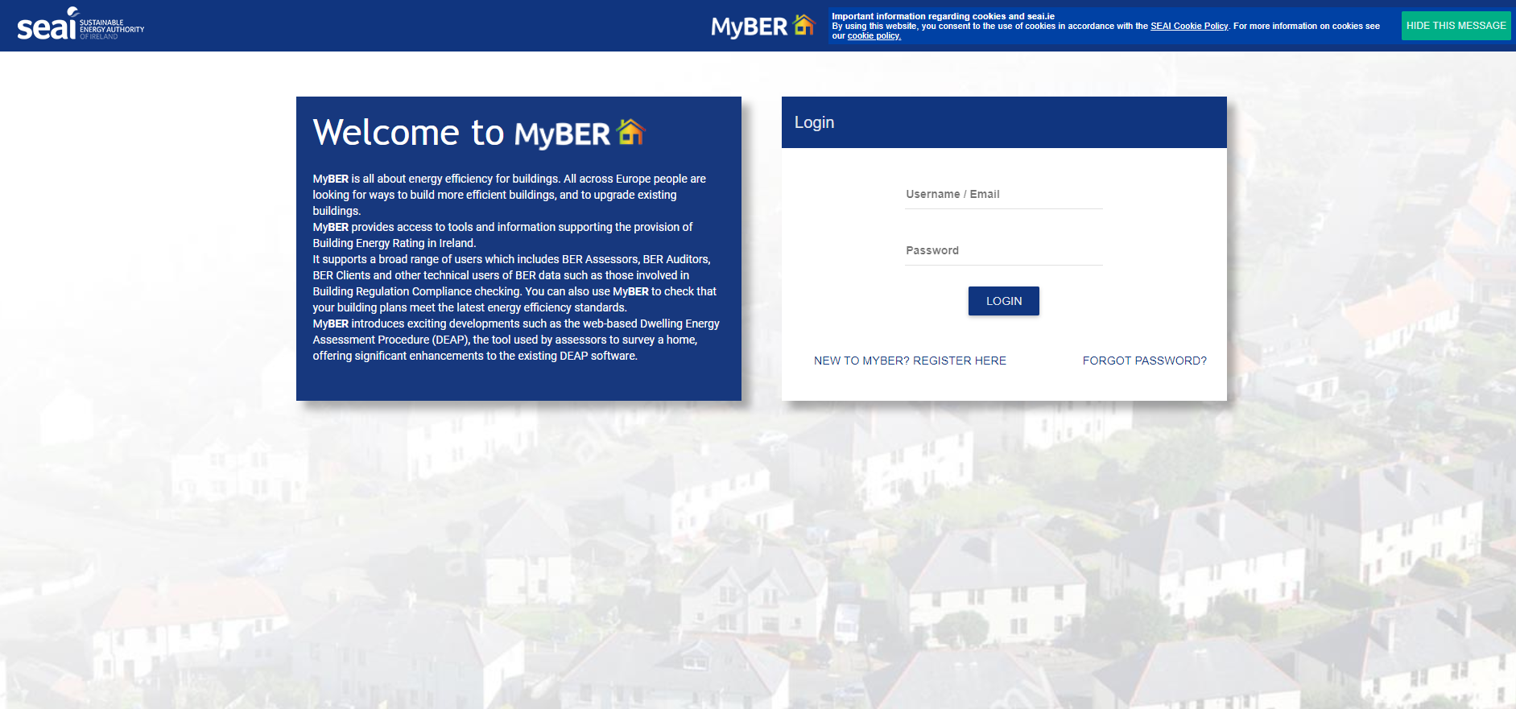
Software/ Documentation
https://www.seai.ie/home-energy/building-energy-rating-ber/support-for-ber-assessors/domestic-ber-resources/

Slide 18
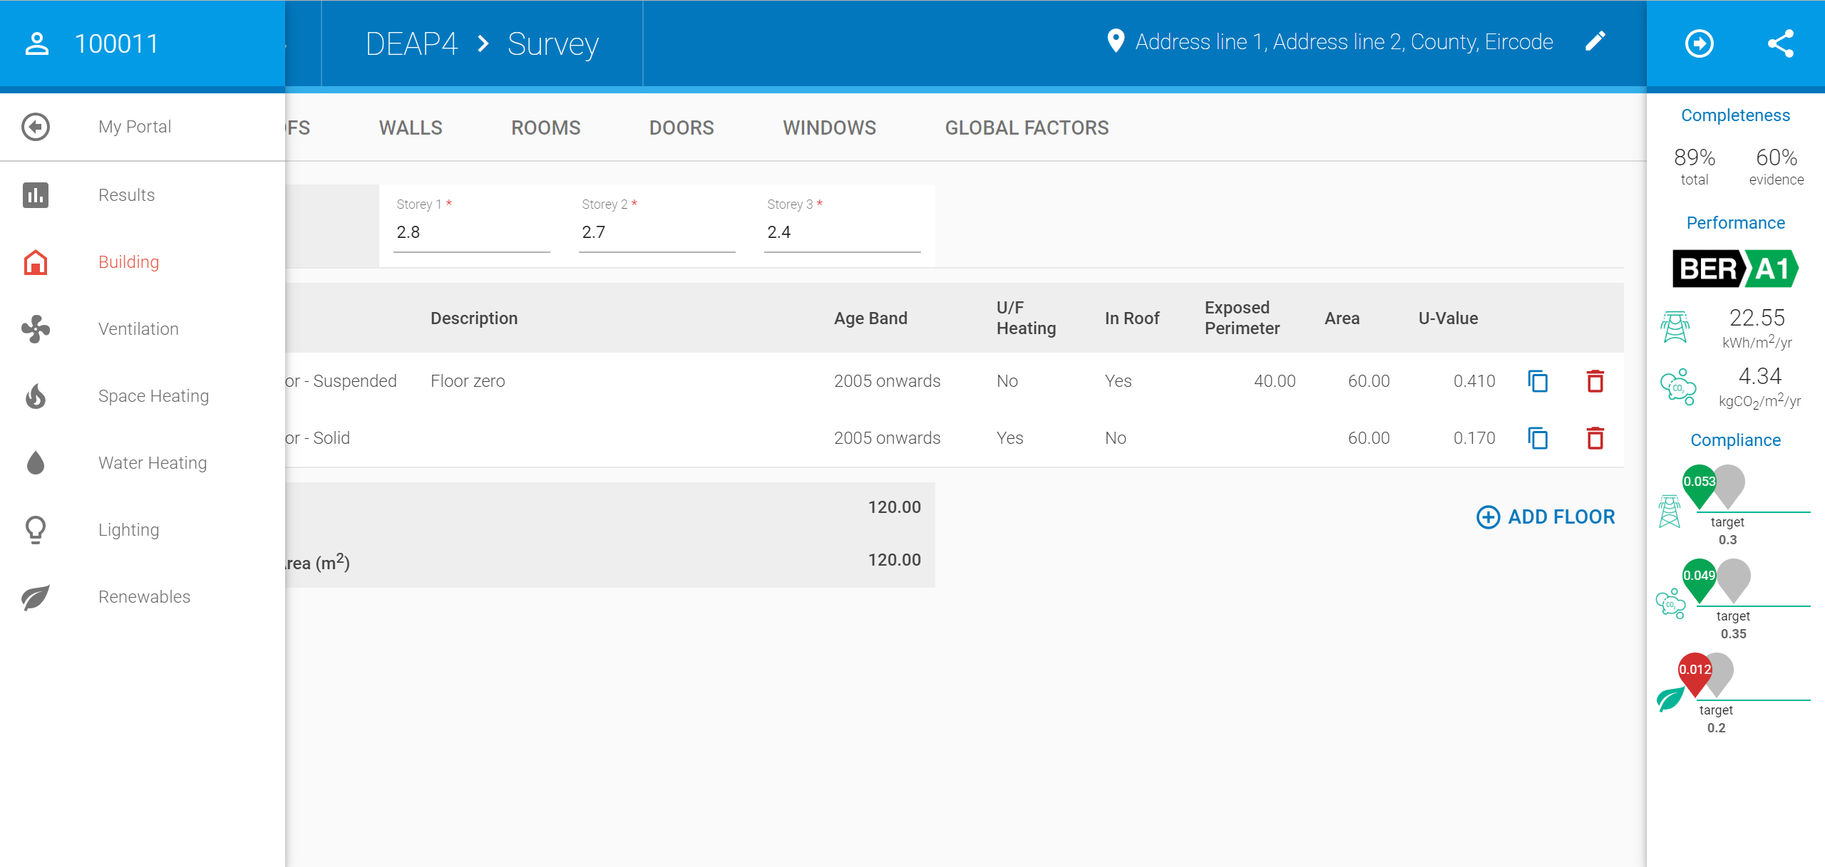
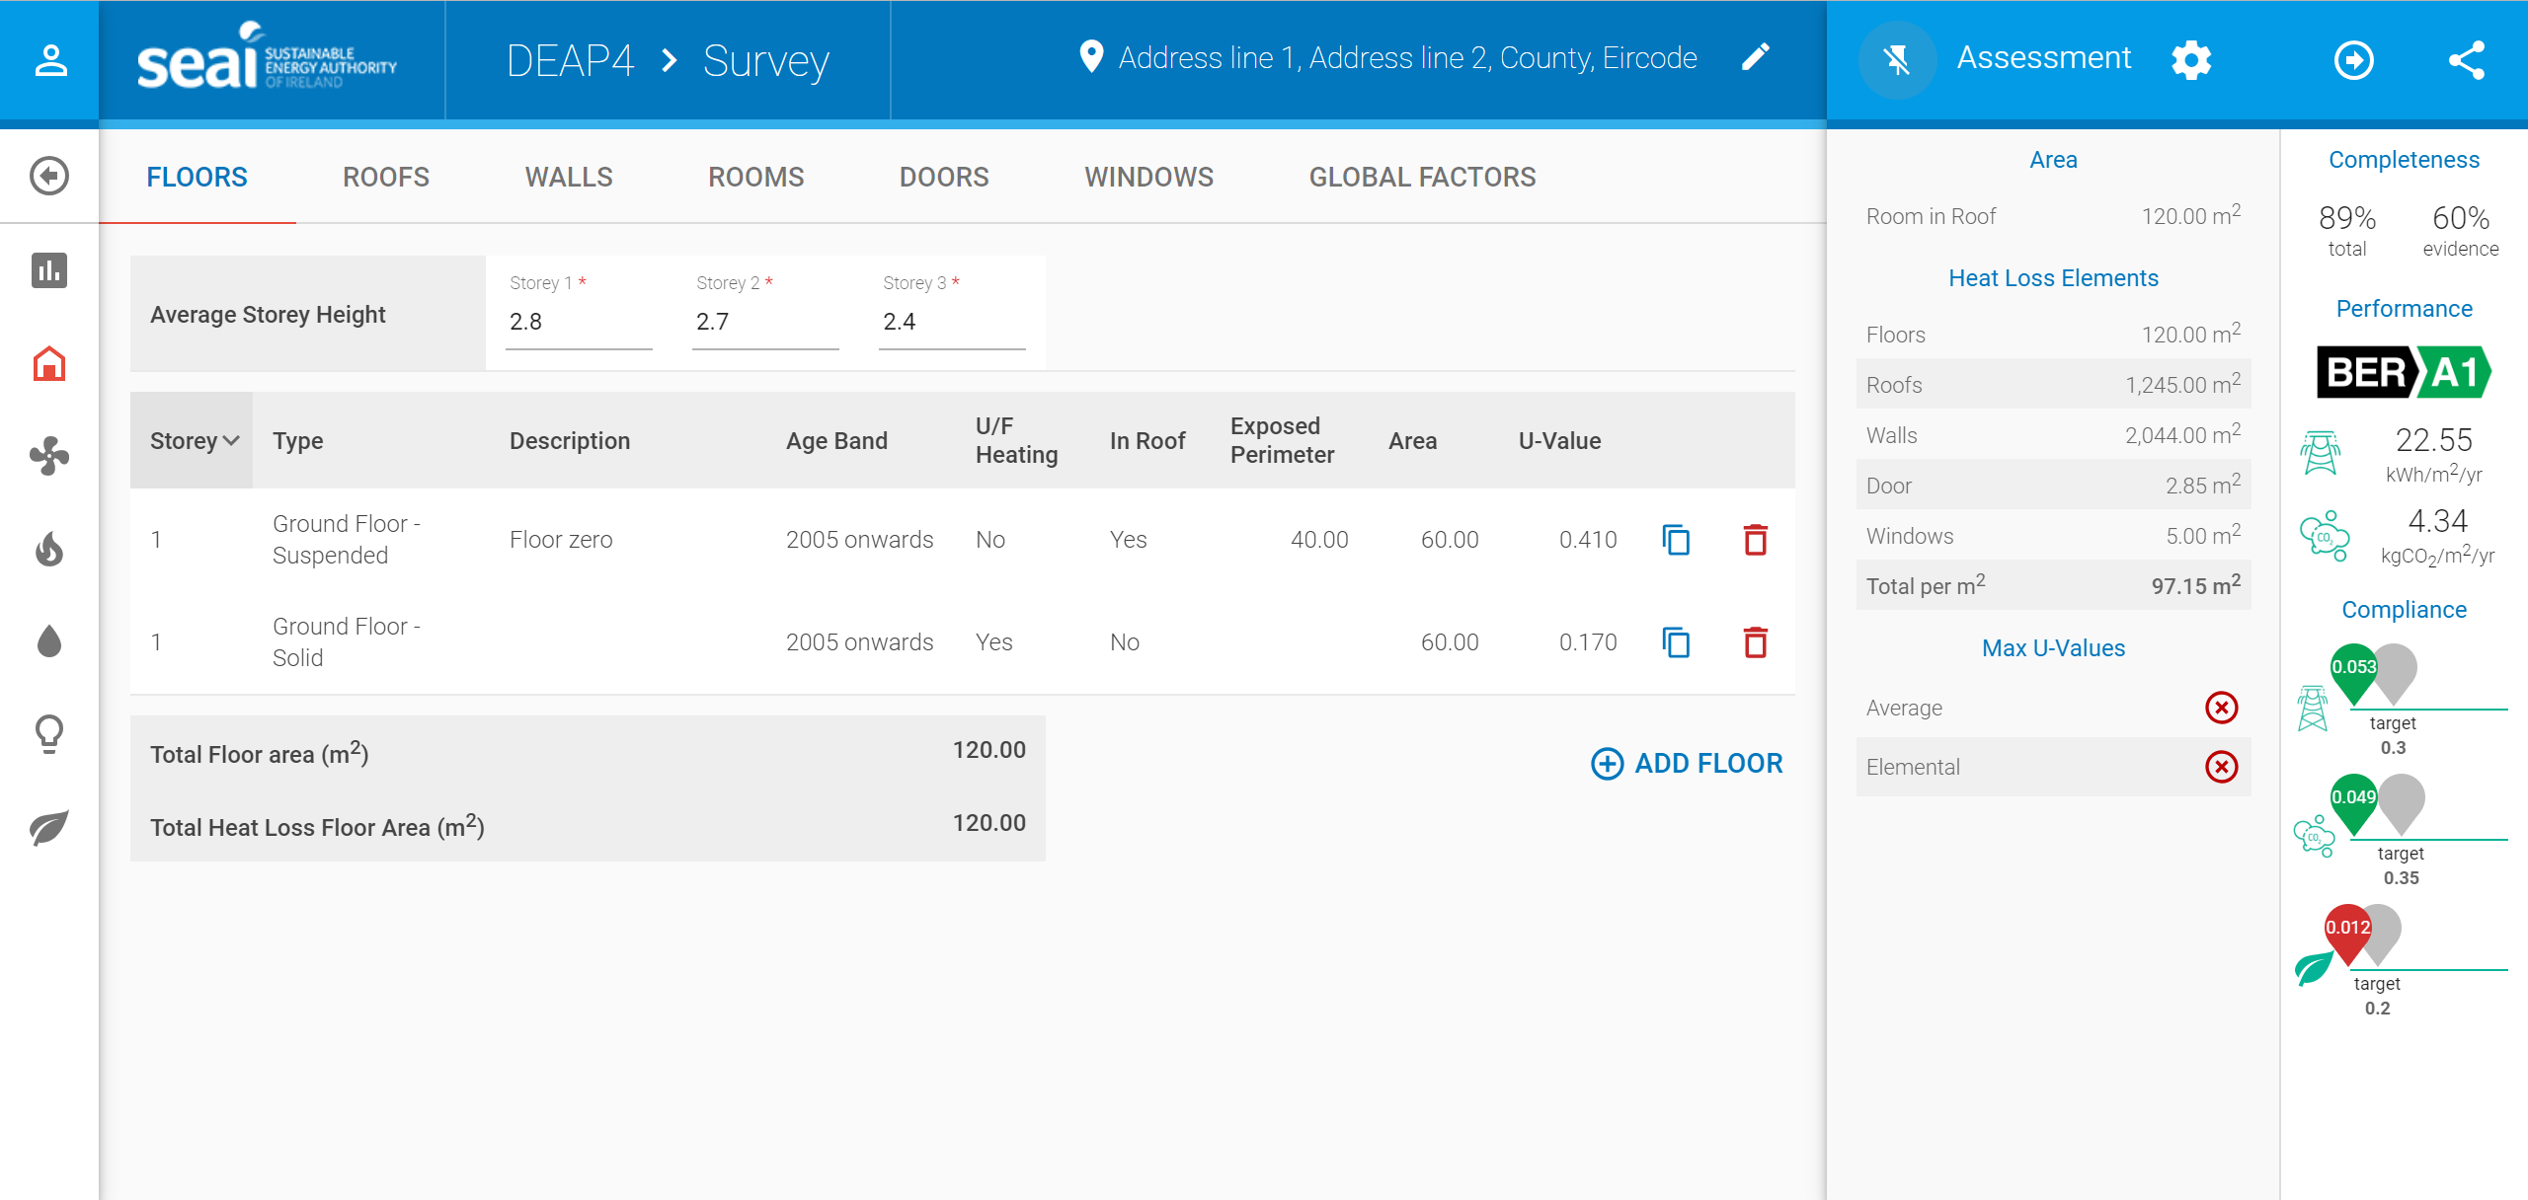
DEAP 4.2.0

Slide 19
Water Heating – Changes to energy demand calculation
New methodology will take account of
Updated occupancy rates
Shower types and presence of baths
Electricity used by electric showers
Low water use fittings

Slide 20
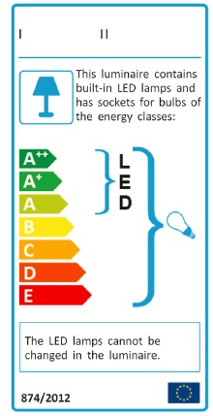
DEAP Methodology – Lighting Energy
Portable Lighting:
Efficiency improved based DECC (UK) of the Household Electricity Survey (HES) in June 2013
21 lumen/W
Fixed lighting:
New buildings: the assessor enters details based on design of the installed lighting, including Wattage, Efficiency and/or Lux levels.
Existing buildings, the assessor enters default efficiency based on the lamp type/ rating with the lighting level fixed.

Slide 21
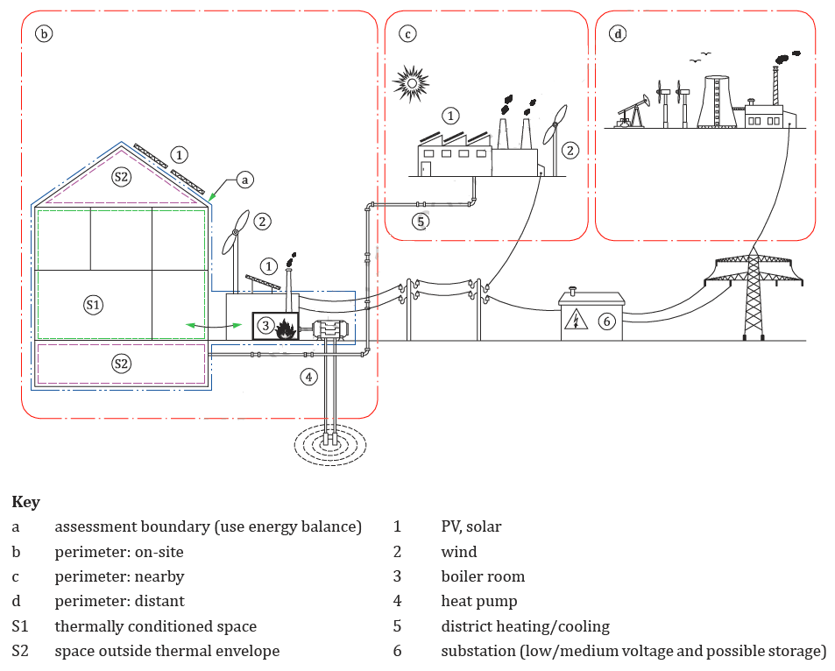
Renewable Energy Ratio
Calculated in line with ISO 52000
Included:
  PV
  Solar
  Wind
  Heat Pump
  Biomass/ Biogas
  District heating
  CHP
The Renewable Energy Ratio RER = E_{Pren} Primary Energy of the Renewables
E_{Ptot} Total Primary Energy

Slide 22
Part F

Slide 23
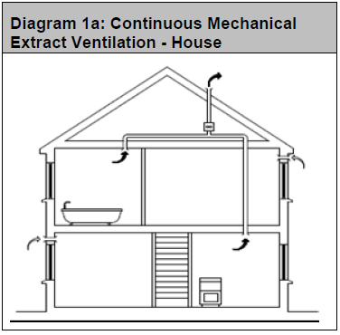
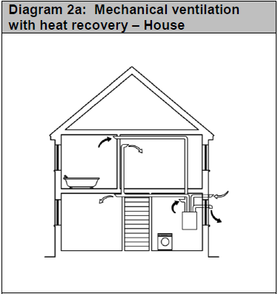
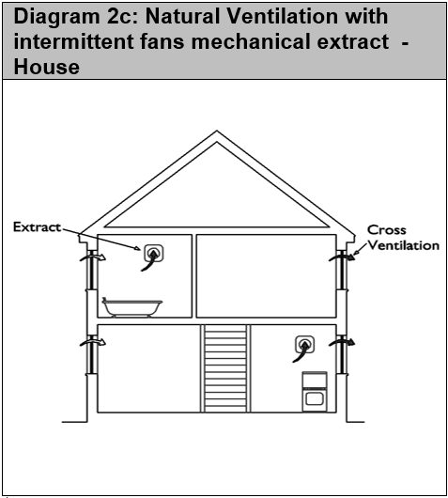
TGD F 2019
Continuous Mechanical Extract Ventilation - New
Exhaust Air Heat Pump to be treated as CMEV

Slide 24
TGD F 2019 – Ventilation System Application range
1.2.4: Natural ventilation with intermittent extract
Minimum (total) equivalent area of background ventilators increased by 40%.
Ventilation System | Air Permeability range: 3-5 m³/h.m² | Air Permeability range: Less than 3 m³/h.m²
CMEV | ✔ | ✔
MVHR | ✔ | ✔
Natural Ventilation with intermittent extract ventilation | ✔ | ✖
Notes:
Part L backstop values interlinked with part F ventilation strategies. All houses to be air tightness tested.
NV: If achieved Air tightness is lower than design air tightness of 3, then appropriate additional measures should be implemented to ensure adequate ventilation.

Slide 25

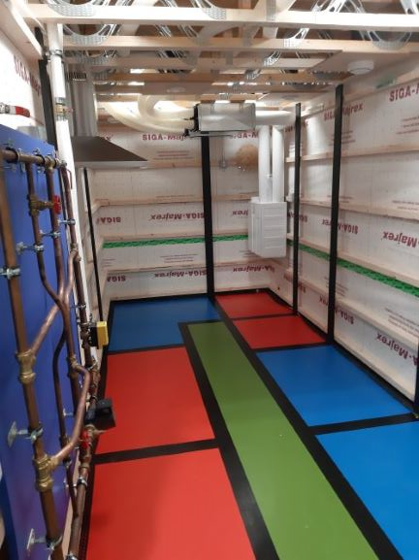
Competent Installers
Systems should be installed, balanced and commissioned by competent installers e.g. QQI or ETB or equivalent.
Applies to New Build and where cMEV/ MVHR installed under Major Renovation
Waterford and Wexford ETB – NZEB National Training centre, Enniscorthy
Notes:
Quality and Qualifications Ireland
Education Training Board

Slide 26
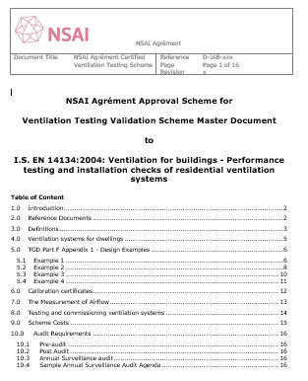
NSAI Ventilation Testing Validation Scheme
Systems should then be validated - to ensure that they achieve the design flow rates - by an independent competent person certified by an independent third party e.g. NSAI or equivalent.
National Standards Authority of Ireland
NSAI currently consulting with Ventilation industry
Based on I.S. EN 14134:2004 Ventilation for Buildings – Performance Testing and installation checks of residential ventilation systems
Similar to Certified Air Tightness Tester Scheme (created 2011 – 65 testers in 2019)

Slide 27

Going Forward

Slide 28
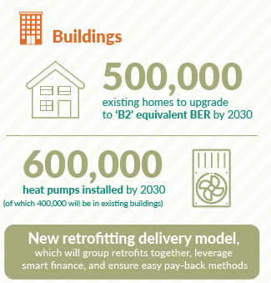
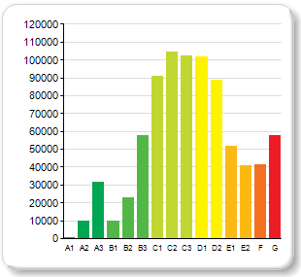
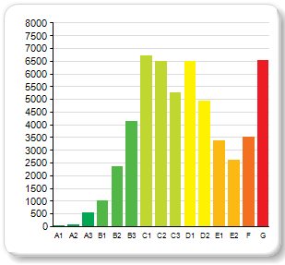
Energy Performance of Buildings Directive 2018
Long Term Renovation Strategy - NZEB by 2050
All of Government – Climate Action Plan

Slide 29

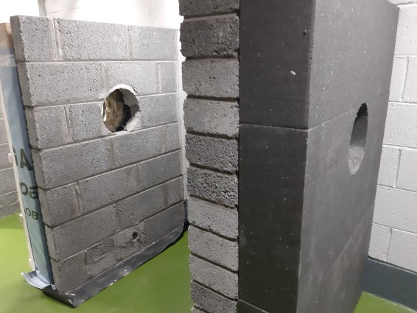
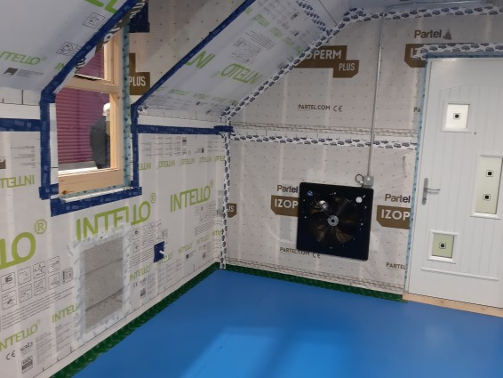
Upskilling
WWETB
Developed National Skills Specification for NZEB, to be rolled out nationally
Suite of NZEB Training Courses - Electrical, Plastering, Carpentry, Bricklaying, Plumbing, Site Supervisor, Installation and Commissioning of ventilation systems

Slide 30
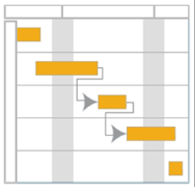
Questions

